Slide 1
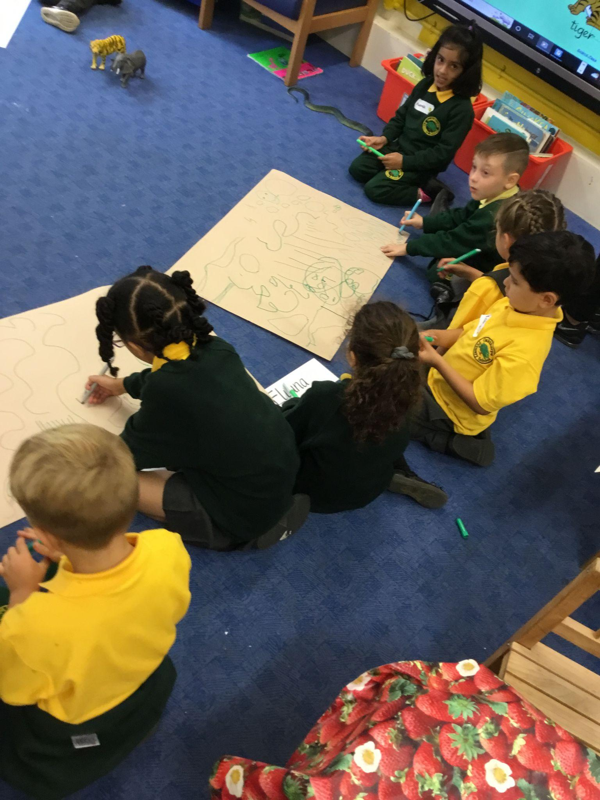
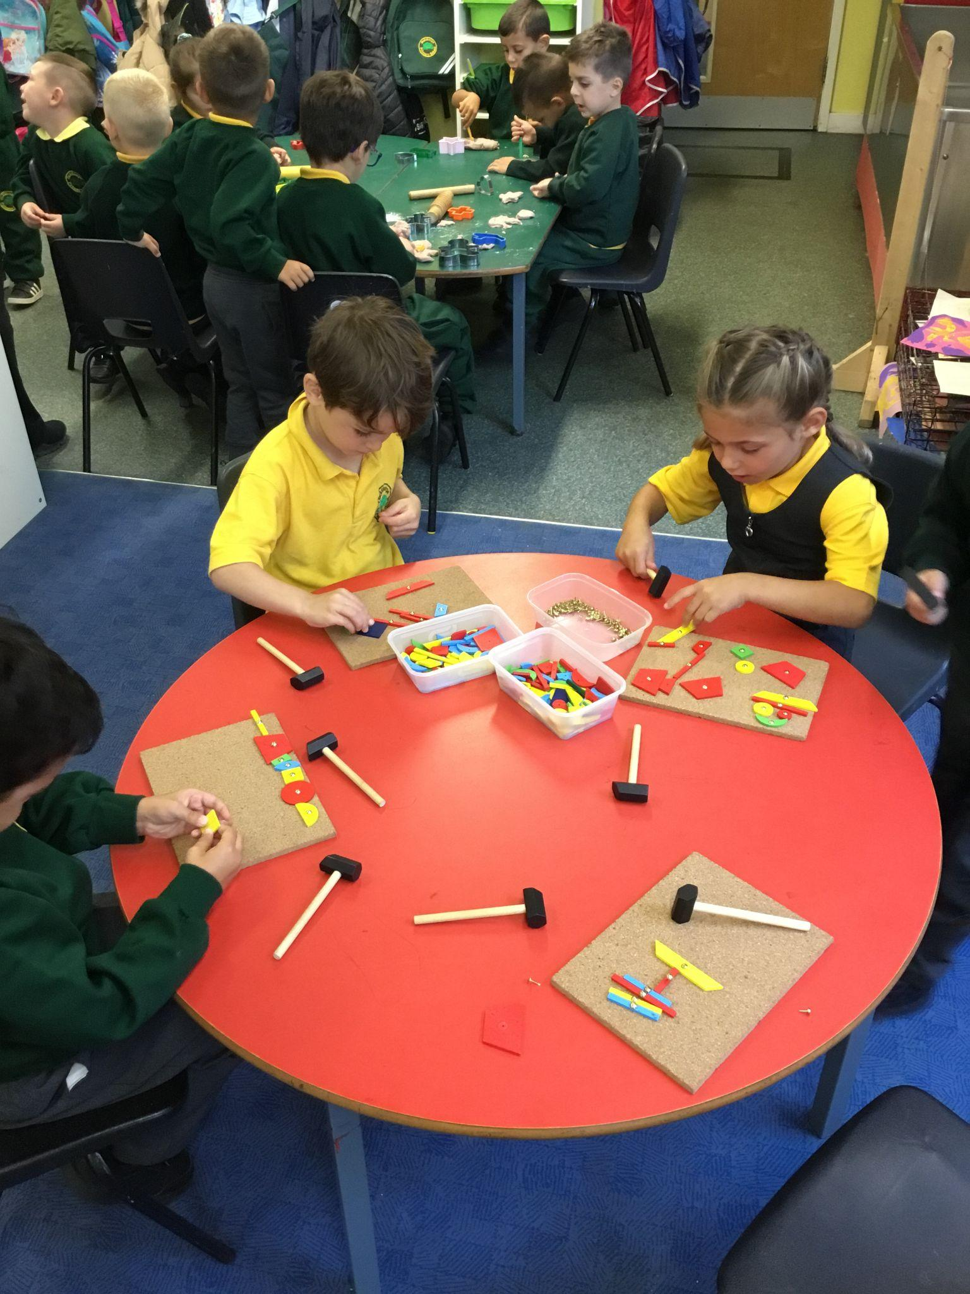
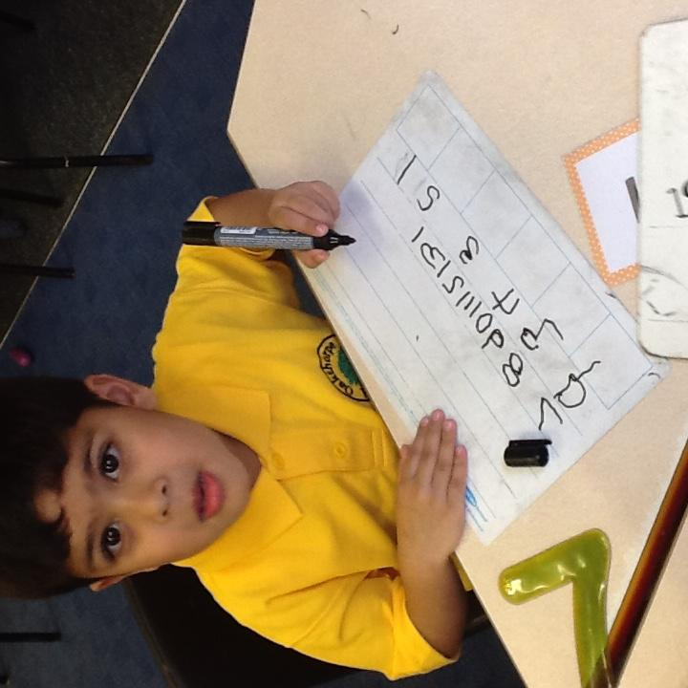
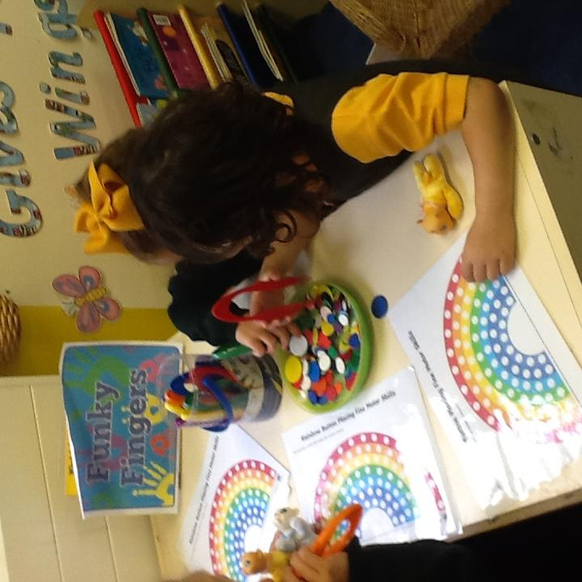

Parent Information
2024

Slide 2
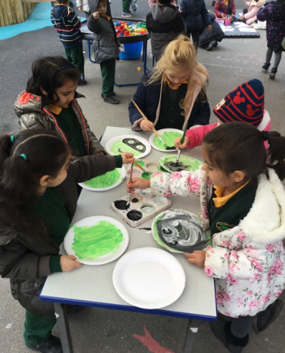
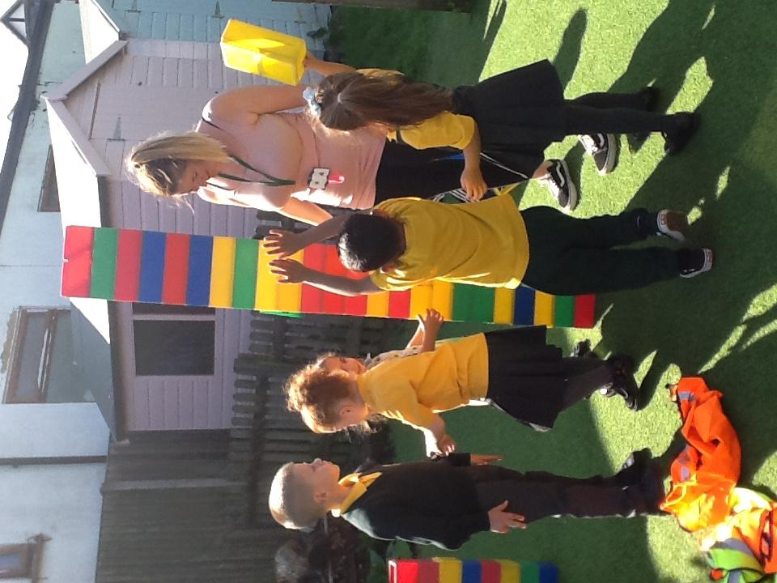
Our Early Years
We have two separate classes in Reception, each with a Class Teacher and a Nursery Nurse.
We also have a range of support staff who work with the children supporting their academic, communication and social development too.
As well as having large classrooms, we have two smaller rooms where children can carry out group activities such as games, stories and cooking and a large outdoor area.
Our outdoor area comprises of different covered learning spaces, a mud kitchen, bug hotel, undercover areas, a large field and climbing and balancing equipment.
“The Early Years provides a stimulating learning environment where children explore independently and learn through structured learning activities. Planned activities are exciting, and encourage children to use all their senses to build their knowledge and understanding of the world. “
- OFSTED 2019

Slide 3
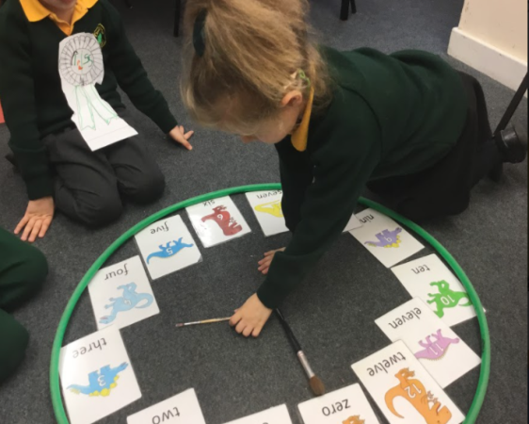
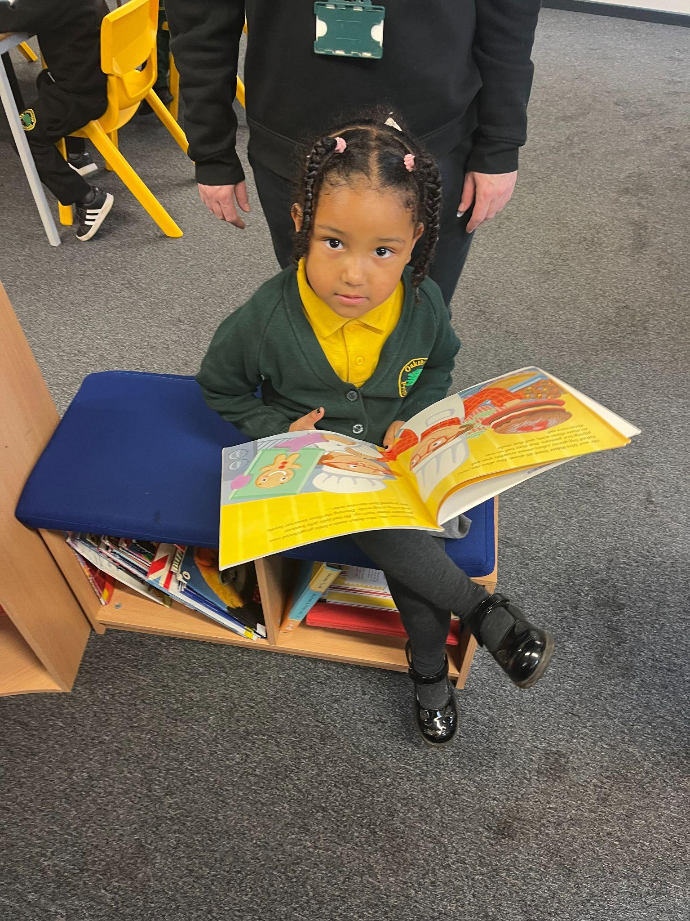
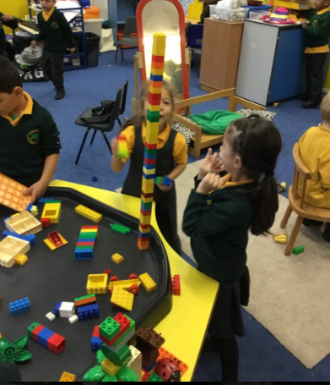
A School Day in Early Years
Every day we have 3 carpet lessons. Typically these will be based on Literacy and Maths topics as well as a Phonics lesson too.
Each day we also have child led learning, whereby children can choose which resources they would like to learn with and whether to learn inside the classroom or outside. The children also have the option of playing and learning in the other reception class too.
Each day the teachers will set up activities that the children can learn with too. These will be based on our theme for the half term.
Teachers will lead focus activities with your children whereby your child will complete a set learning activity to develop their skills. These activities will be tailored to your child.
We have fruit time each morning and afternoon, lunchtime at about 12pm. We also have story time daily.

Slide 4

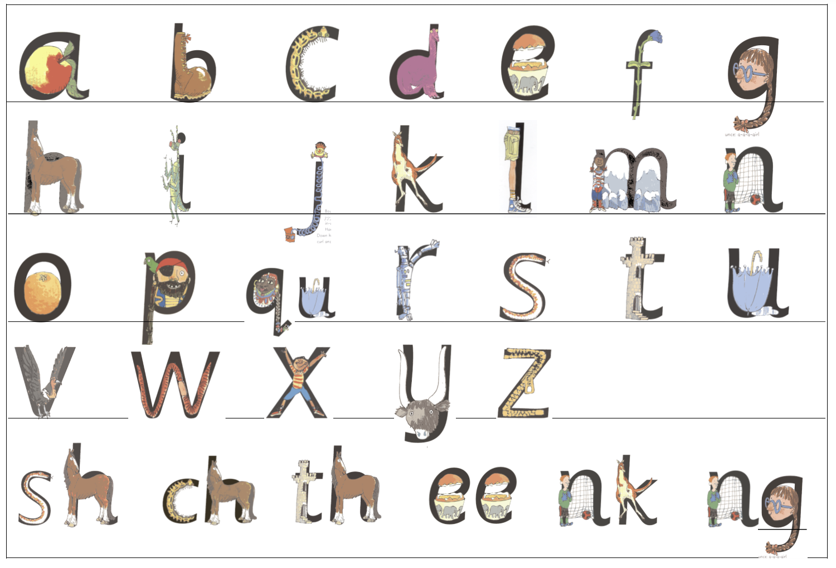

Starting School Packs
Contains information for both you and your child.
We recommend your child trying some of the activities in the pack before starting school.

Slide 5
Home Visits
Every child will be given the opportunity for a home visit.
Your class teacher and nursery nurse will come to visit you at your home on the date/time arranged.
During the visit the teacher will ask some questions to ensure we have all the information we need to make your child's start to school as smooth as possible. You can ask any questions you may have as well. We also bring activities from the classroom for your child to play with during the visit.
If for any reason you can’t arrange a home visit with us, we can offer a virtual meeting. We do however, recommend an in person home visit wherever possible. Please let us know now of any parking restrictions.
Please ensure you have made an appointment before leaving this meeting.

Slide 6

Play Session
Each class will have a play session – a chance for the children to meet each other and their teachers before starting school.
Butterflies
Wednesday 11th September at 10am -11am
Bumblebees
Wednesday 11th September at 2pm -3pm
These will last for an hour. Children can attend with one adult only.
They will have the opportunity to see their classroom, play in the outdoor area and find their peg and tray ready for them to start school.
Children do not have to wear school uniform for this session.

Slide 7
Starting School Dates
To ease your children into starting school we split them into three smaller groups. By having smaller groups start at a time, it enables teaching staff to support your child's transition into their school life at Oakthorpe.
Group 1 Children will start school on: THURSDAY 12th September
Group 2 Children will start school on: MONDAY 16th September
Group 3 Children will start school on: FRIDAY 18th September
Children will be in for the whole school day.
School starts at 8.45am.
School Finishes at 3.25pm
Children should be dropped off and picked up from their classroom door.

Slide 8
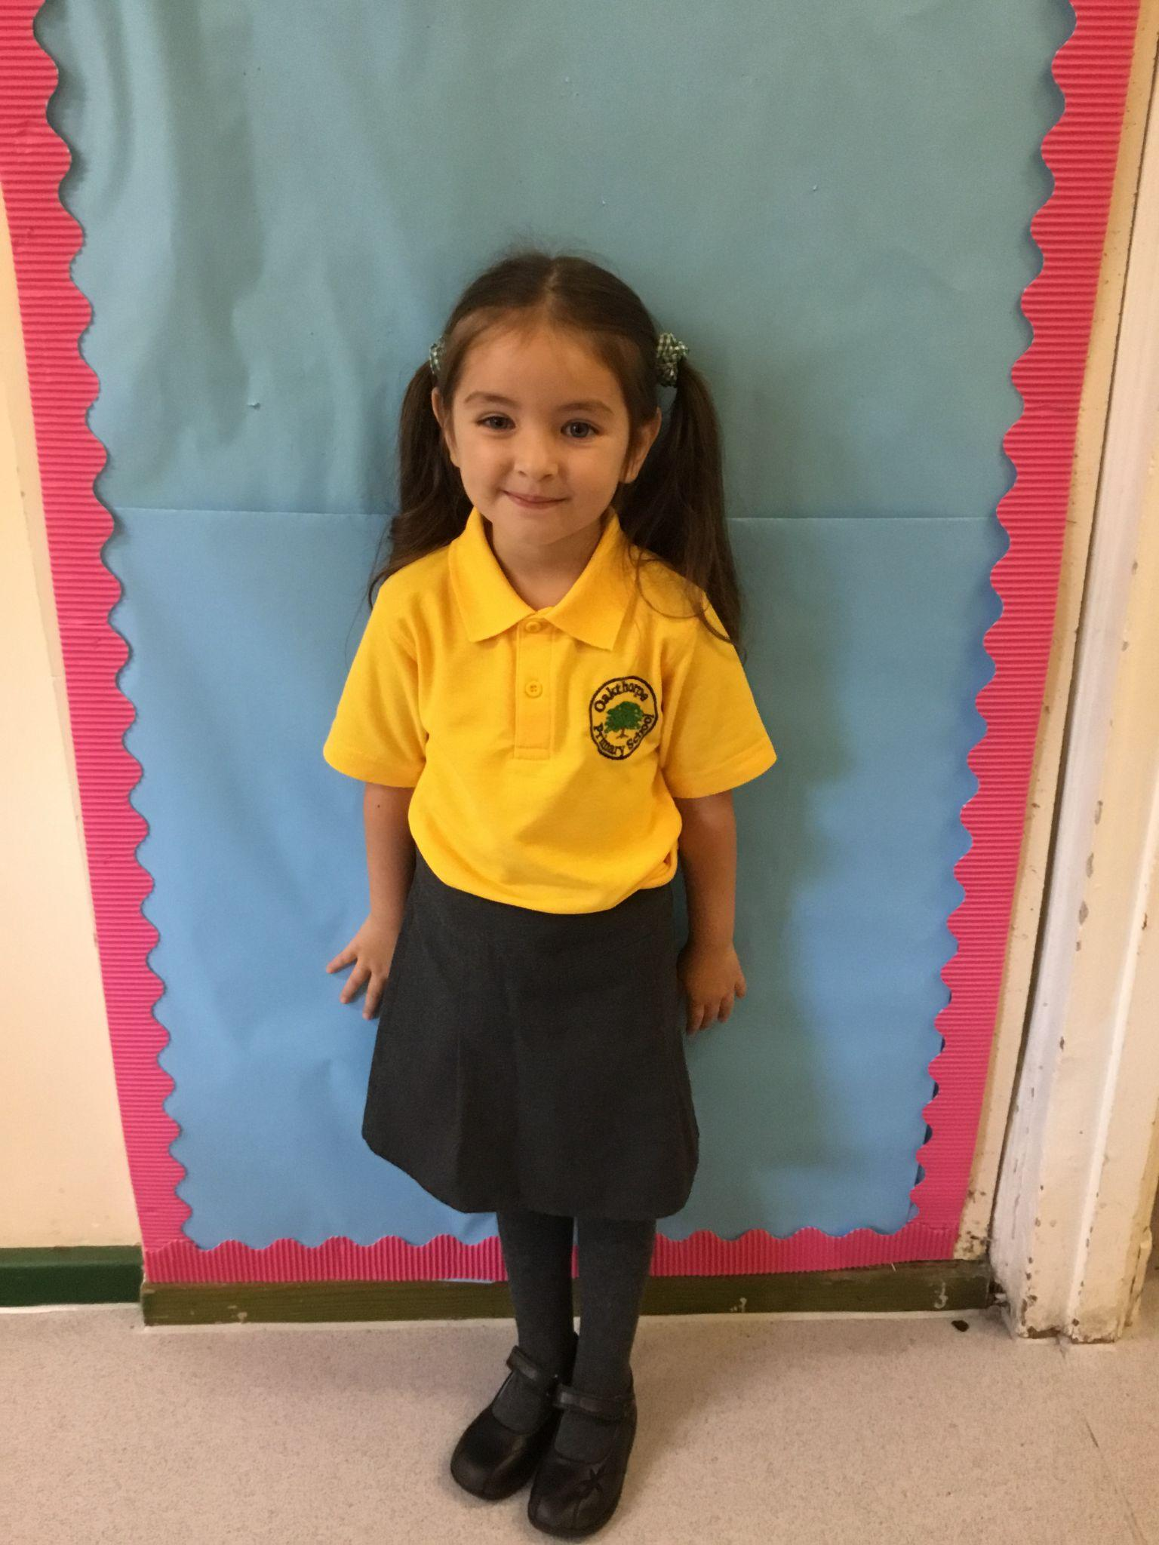
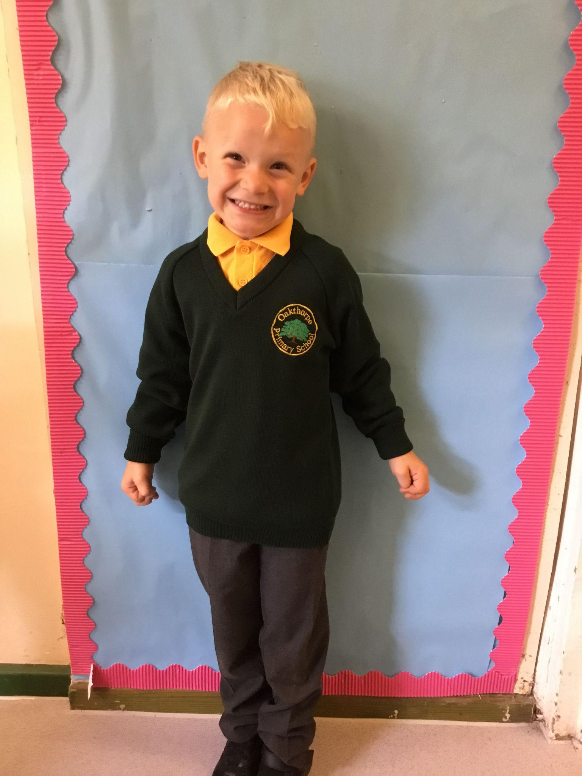
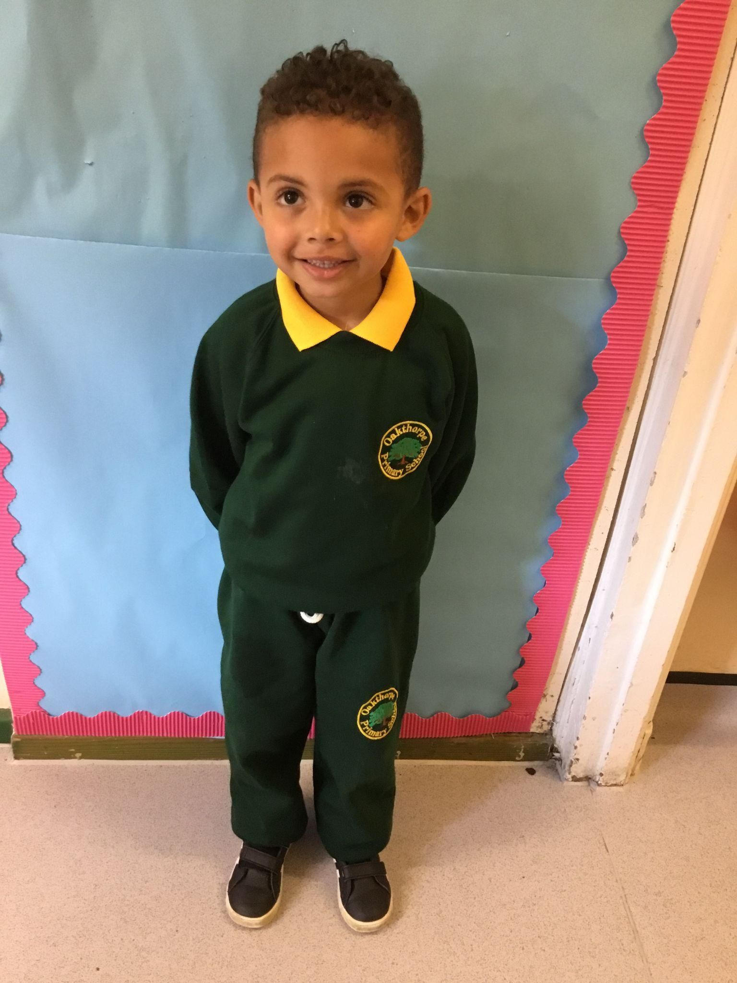
School Uniform
PE KIT: In your starting school packs is the name of the house your child is in and what colour PE t-shirt they will need.
Children will use the outdoor area in all weathers – please make sure they have appropriate clothing. We recommend having a pair of wellies in school.
Please provide shoes (not trainers) with buckles or Velcro fastenings.
Jewellery is not allowed except earrings. This includes rings or necklaces. Earrings must be studs only.
Please ensure your child has a spare change of clothes in school AT ALL TIMES. This doesn’t have to be school uniform but should include pants, socks, trousers, top.
School uniform can be purchased from Smiths School Wear in Enfield.

Slide 9
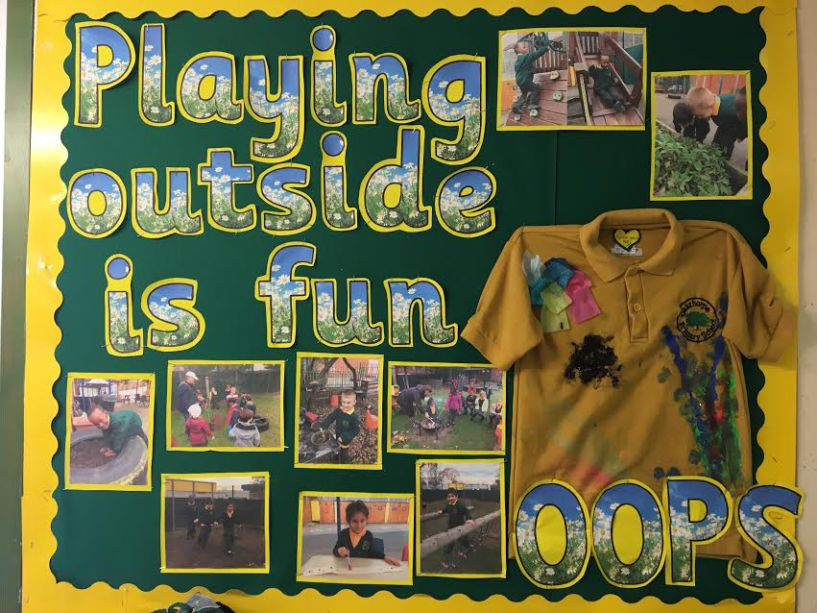
We feel its important for children to explore and experience lots of different activities. We complete activities like painting, messy play, water play, mud kitchen play and sand play. We do encourage your child to wear an apron, and all children should have spare clothes on their peg.

Slide 10
Medical
Head injuries: We will telephone you if your child has hurt their head. Please inform us of any head injuries at home.
Toilet accidents: If your child wets themselves, we will change them and return clothes in a carrier bag. At the Home Visits, we will discuss what actions you want us to take if your child soils themselves.
Illness: If your child has been vomiting or has had diarrhoea, keep your child off for 48 hours after the last bout of illness.
If your child requires medication or an asthma pump, a parent will need to fill in a medical care plan form. Only medication prescribed by the doctor can be administered.
Please inform us ASAP if your child has any allergies.

Slide 11
Fruit Time & Cooking Money
Your child should bring 2 pieces of fruit with them each day. We have two fruit times at the start of the year, on in the morning and one in the afternoon.
Please provide your child with a water bottle. This can be kept at school or refilled at home.
Cooking Money is £20 for the whole year. This is used to buy ingredients for the children to make and taste different food. This will be paid online via Parent Pay. Details for this will be sent to you.

Slide 12
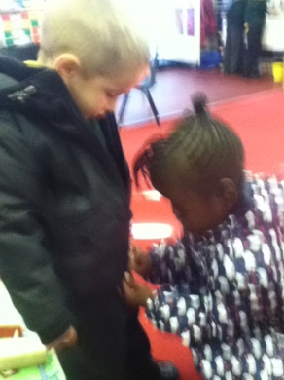
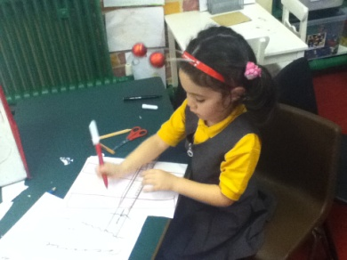
How You Can Help Your Child Prepare For School
If your child is having a packed lunch, please practise with your child opening and closing the lunch box.
If your child is having a school dinner please practise using a knife and fork.
Practise doing up their coats and buy shoes with Velcro fastenings or buckles.
Please ensure that your child gets a good nights sleep as the school day is tiring! A 4 year old needs between 10 - 13 hours sleep each night.
Play lots of games to encourage fine motor skills such as playdough, threading, painting, drawing and writing.

Slide 13
My First Day
On my first day of school I should bring:
2 pieces of fruit
A pair of Wellie Boots
A spare change of clothes for my peg
Packed lunch (if you’re child is having one)

Slide 14
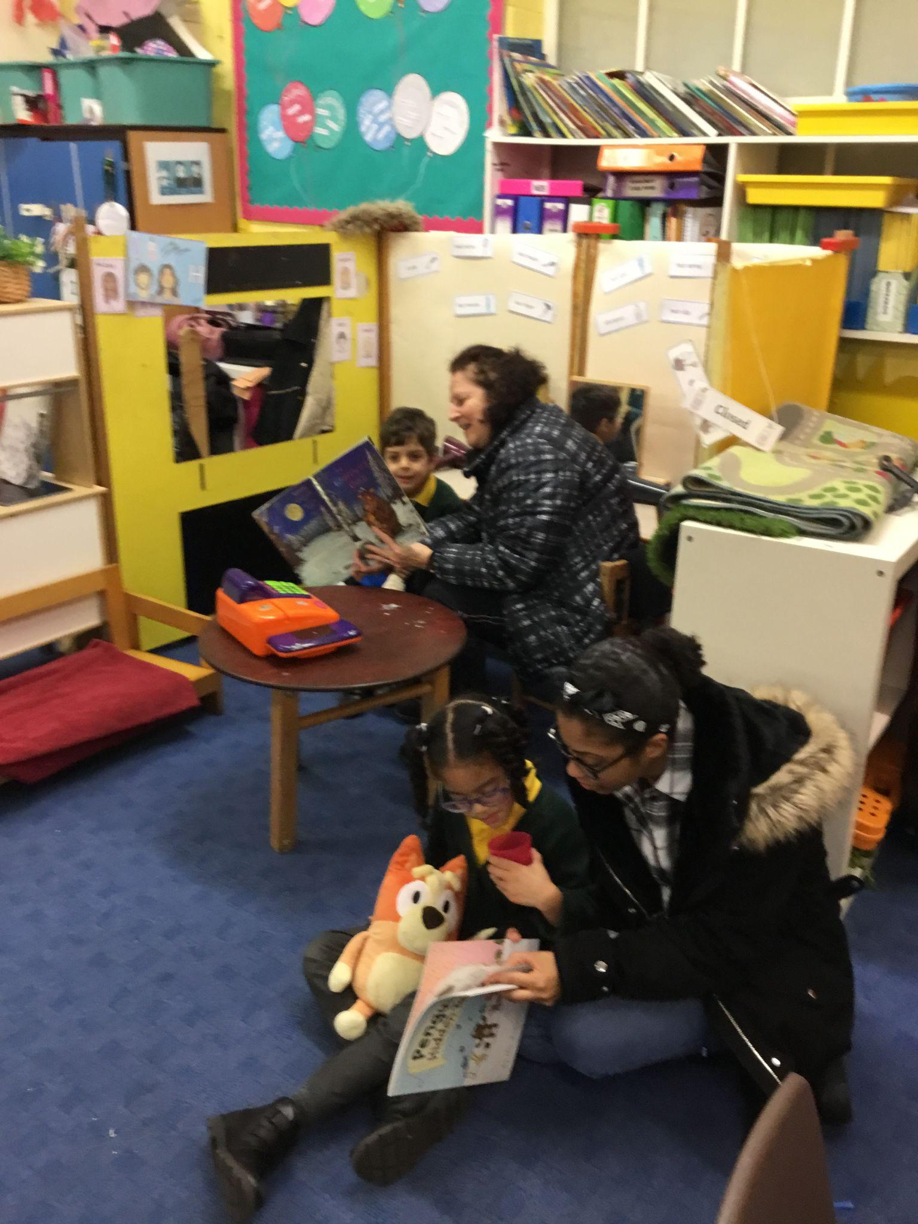
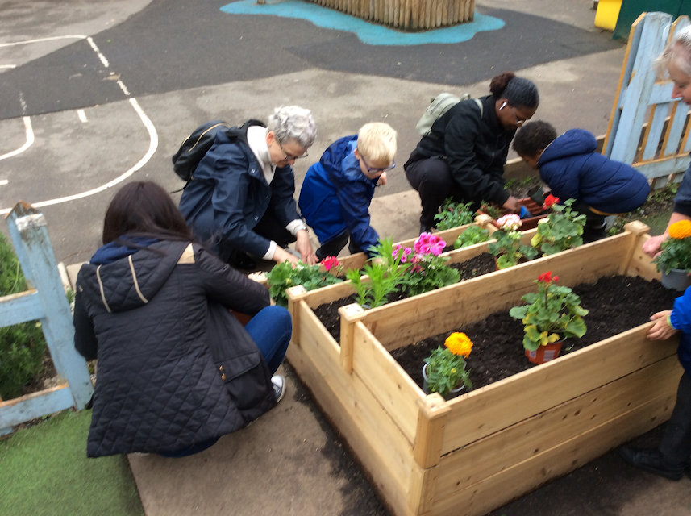


PARENTS…
We Need You!
All parents will have an active part in your child's learning this year.
Learning Cafes
Coffee Mornings
Assemblies and Parent Events
Fundraising Events
But more importantly, you will play such an important role in how well your child does this year!
Google Classroom – online learning platform
Weekly Reading and Key Words

Slide 15
Questions?

Slide 16
Thank you!
All this information will be recapped to you during your virtual home visit or phone call in September.

